Slide 1
WEB APPLICATION DEVELOPMENT PROJECT
MODULE 7: AUDITOR AND DELEGATE MODULE
Nurul Ain Binti Mohamed Nasir 162356
Nurfarah Lyana Binti Zulkiply 179865
Nur Shuhada’ Binti Harris Rizal 179729
Atiqah Adlina Binti Mohd Naziran 180502
Fatin Delailah Binti Adnan 179845

Slide 2
PURPOSE
Auditors play role in audit the account until it is approved by them.
Accountant and auditor can view feedback to correct the account (by accountant).
Each feedback with corrected account will have the version until the account is approved and cannot be edited or changed anymore.

Slide 3
OBJECTIVES
To audit the account.
To invite other auditor to audit the account.
To make sure to be the last person to verify the account.
To make sure the version are provided to the corrected account before being approved.
To make sure the approved account cannot be changed or edit anymore.

Slide 4
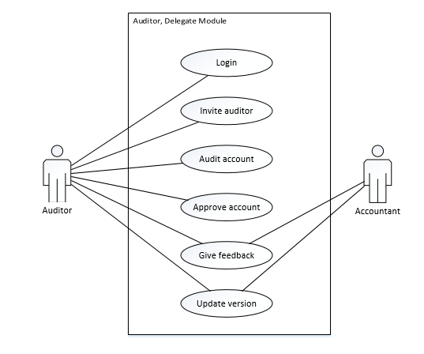
USE CASE

Slide 5
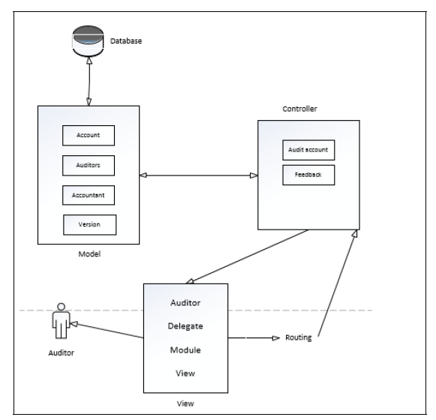
FRAMEWORK

Slide 6
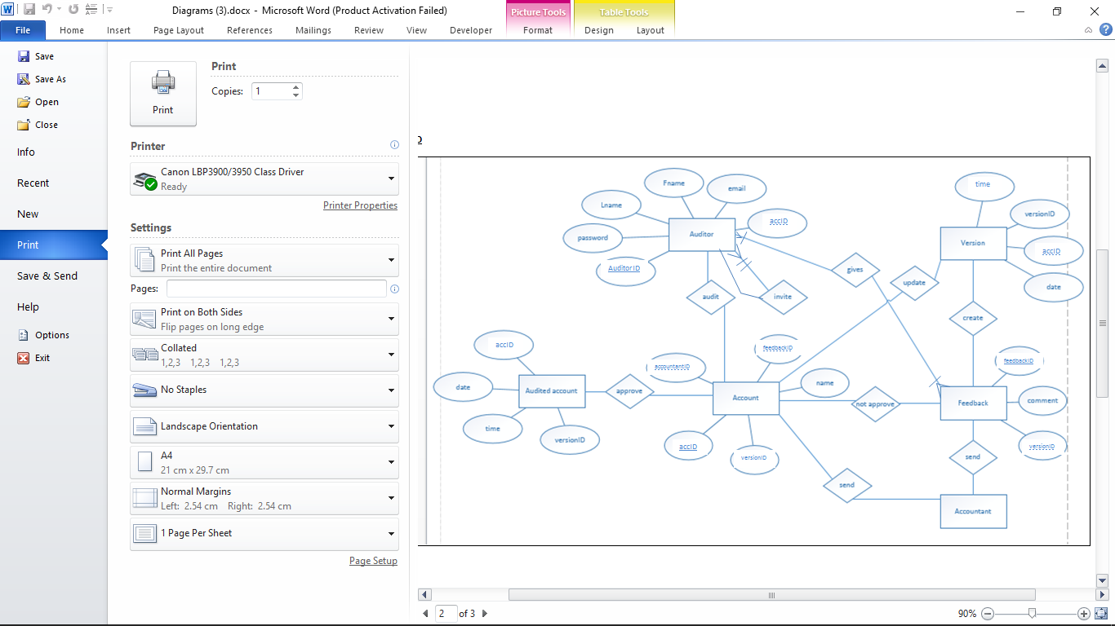
ERD

